Slide 1
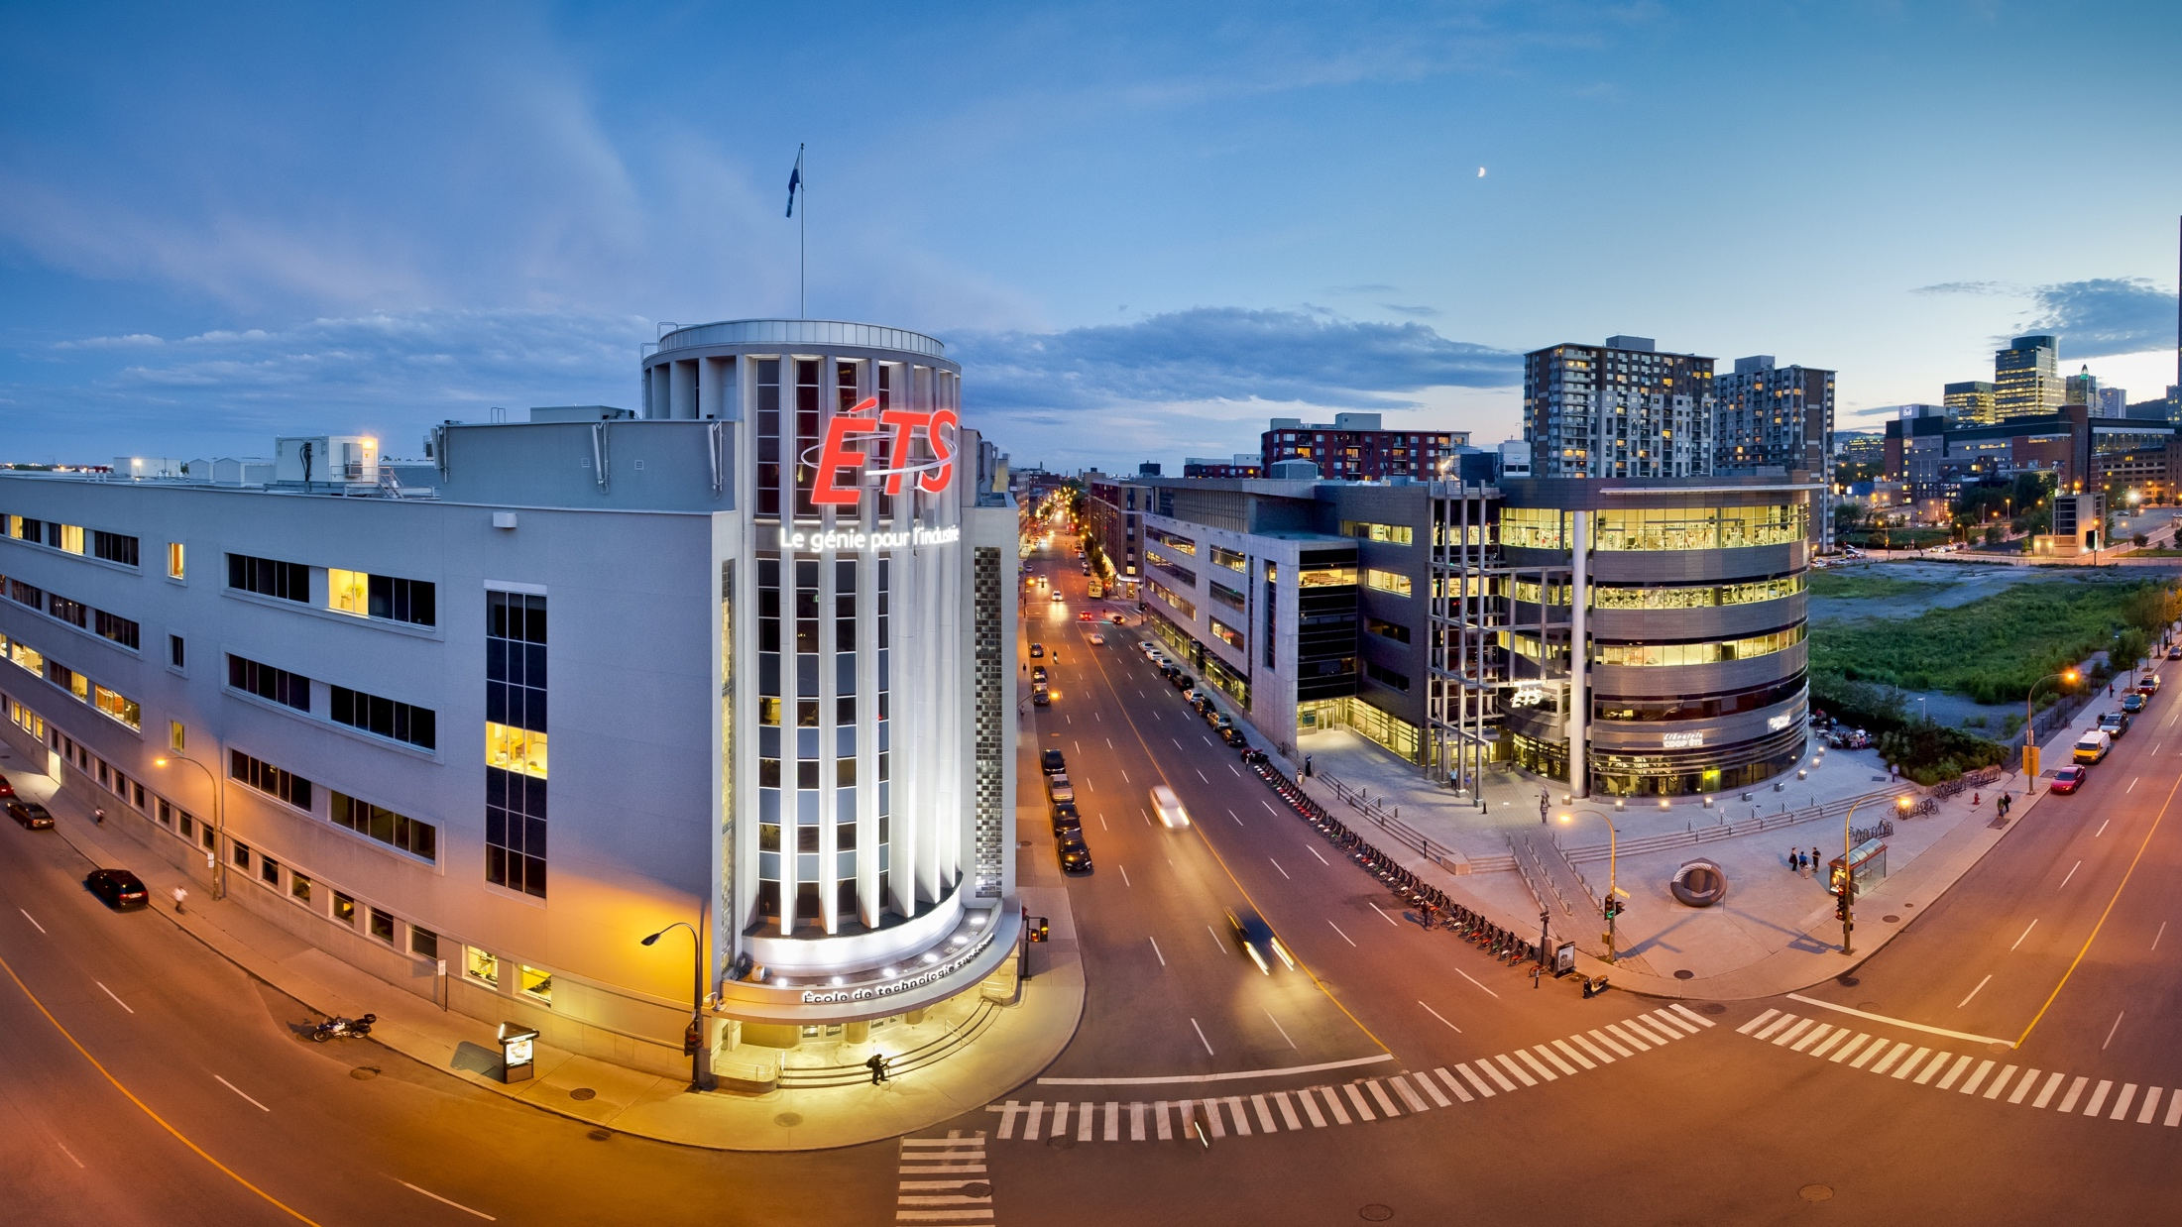


Graph Attention Networks for High Fidelity Thermal field reconstruction from Sparse sensors.
Edwin Oluoch Awino
PhD Student in Construction Engineering
Codirection Prof. Merabtine & Prof. Snaiki
30 January, 2026

Slide 2

Context
55% to 56% of the world's population currently lives in urban areas - projected to rise to 68%–70% by 2050.
This emphasizes the importance of climate adaptation strategies in urban development.
Urban Heat Island (UHI) effect- Urban areas experience higher temperature than neighboring rural area.
To model UHI we need temperature fields
Numerical models?- Costly and time consuming
Traditional interpolation e.g. Krigging? Rely on Euclidean distance.
Research Questions
To what extent can GNN model Temperature field from sparse sensors and remote sensing?
How can temperature field derived from GNN be useful for UHI mapping and improved Urban planning.

Slide 3
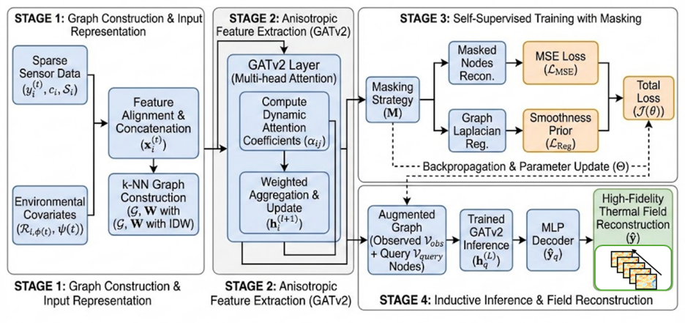
Research Objectives
To develop GNN framework that produces high-resolution Air temperature fields from sparse observations and remote sensing.
To build a pipeline that downscales and bias-corrects CMIP6 scenarios to produce ensemble future UHI realizations.
To use the trained surrogate to discover spatially targeted, budget-aware mitigation policies

Slide 4
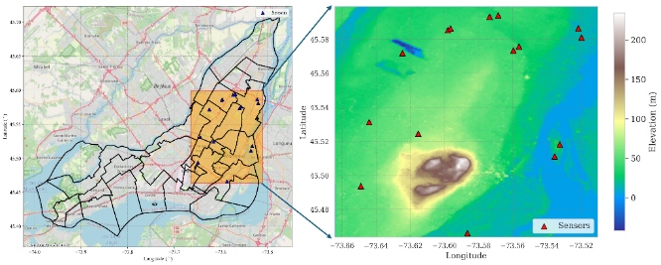
Case Study- Montreal
15 Sparse sensors located over a section of Montreal measuring Ta, RH and dew point.
5 minutes temporal resolution.
No sensors in areas we are likely to experience UHI- such as Old Town Montreal.

Slide 5
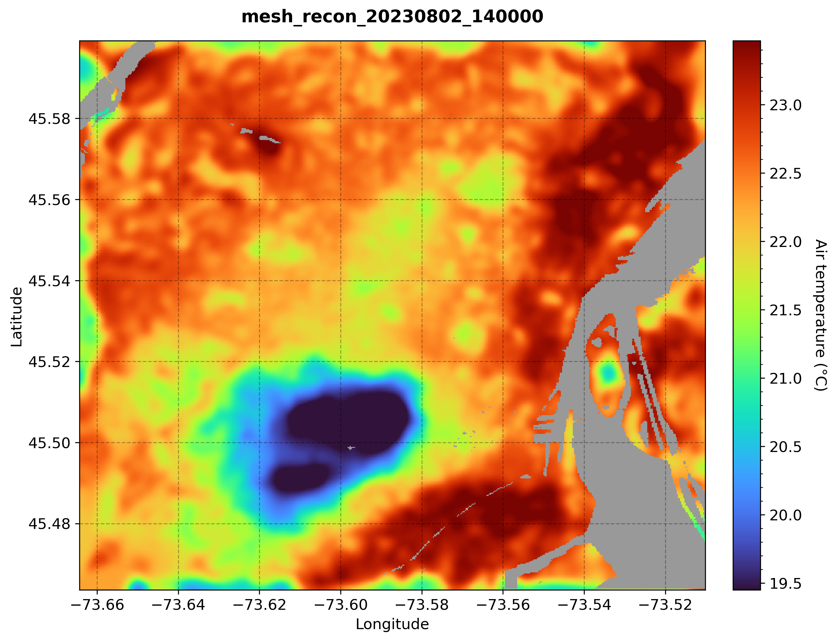
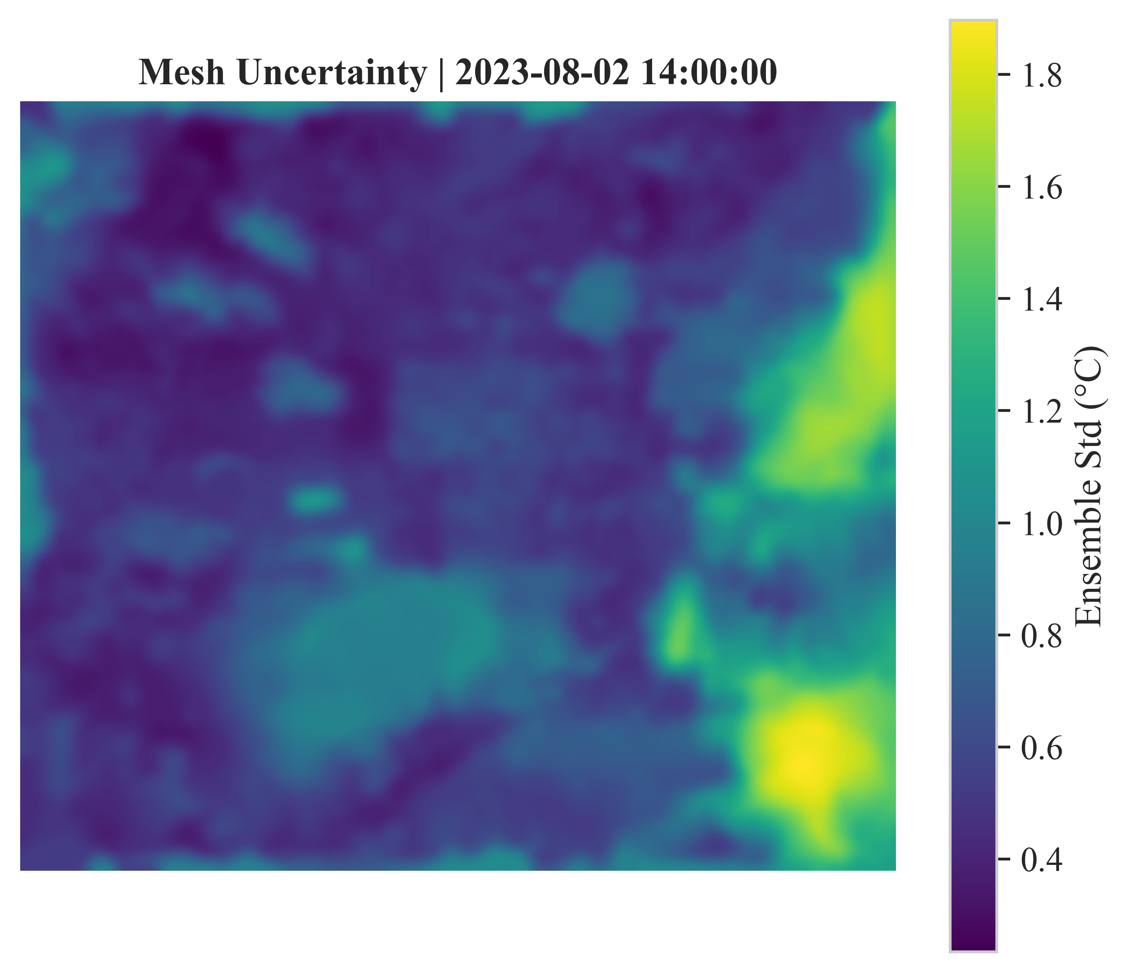
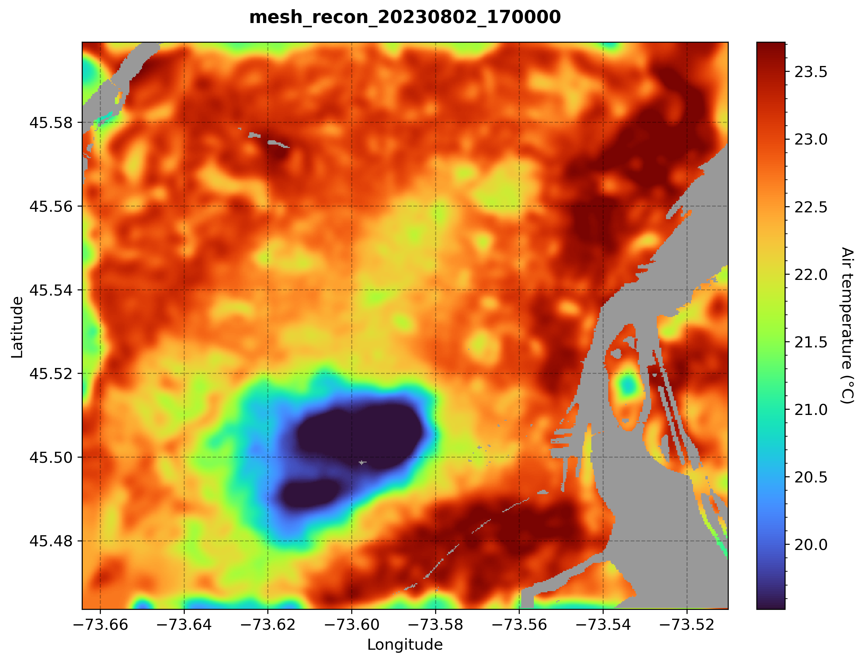
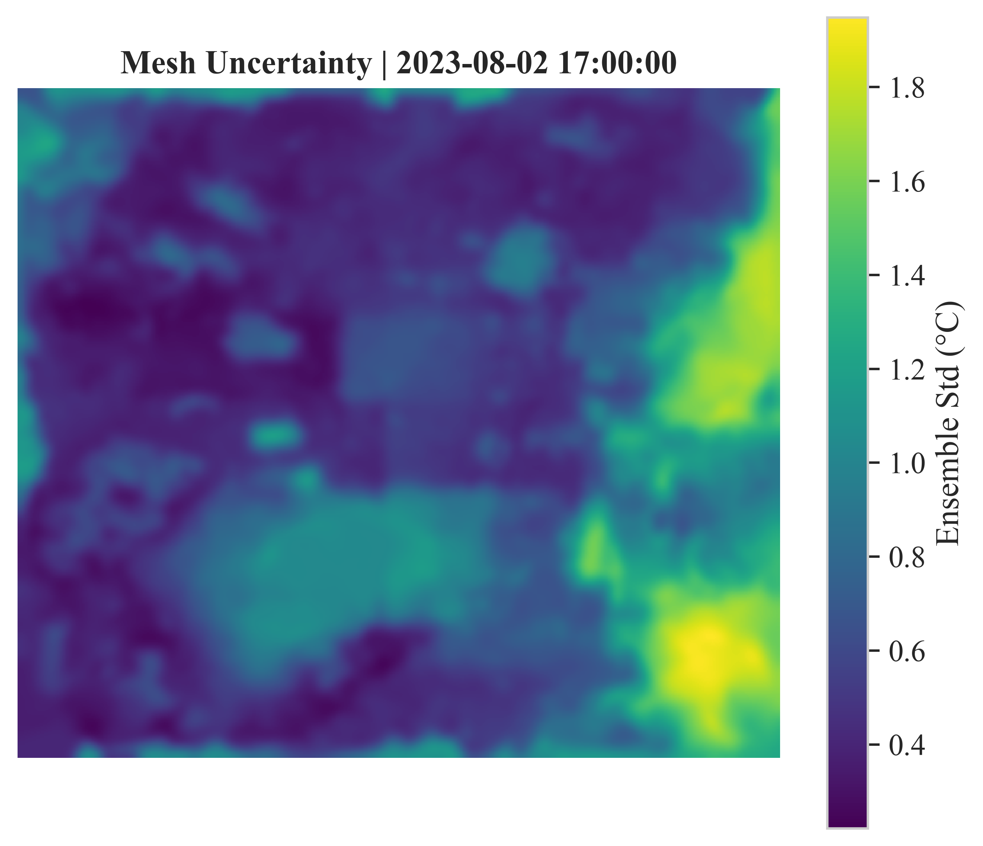
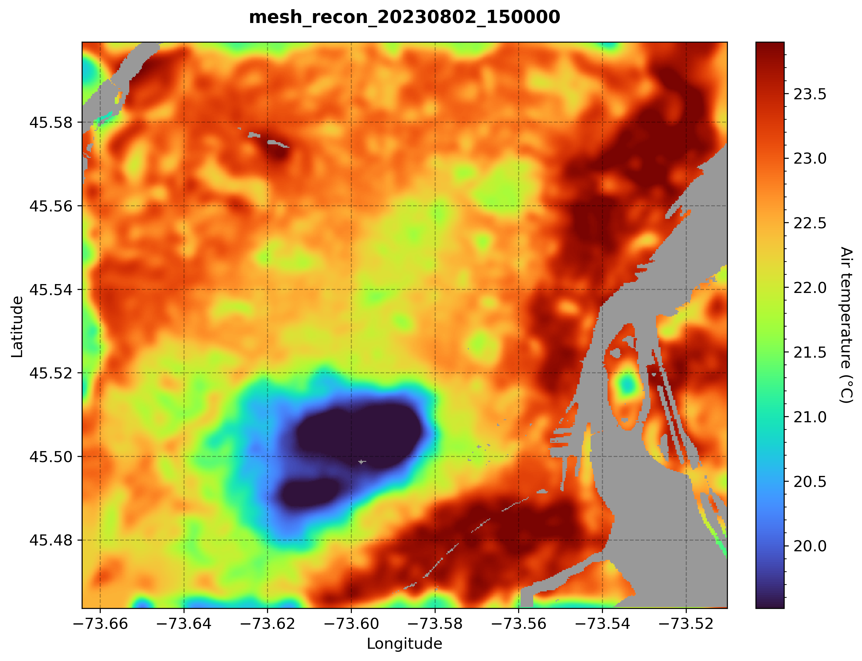
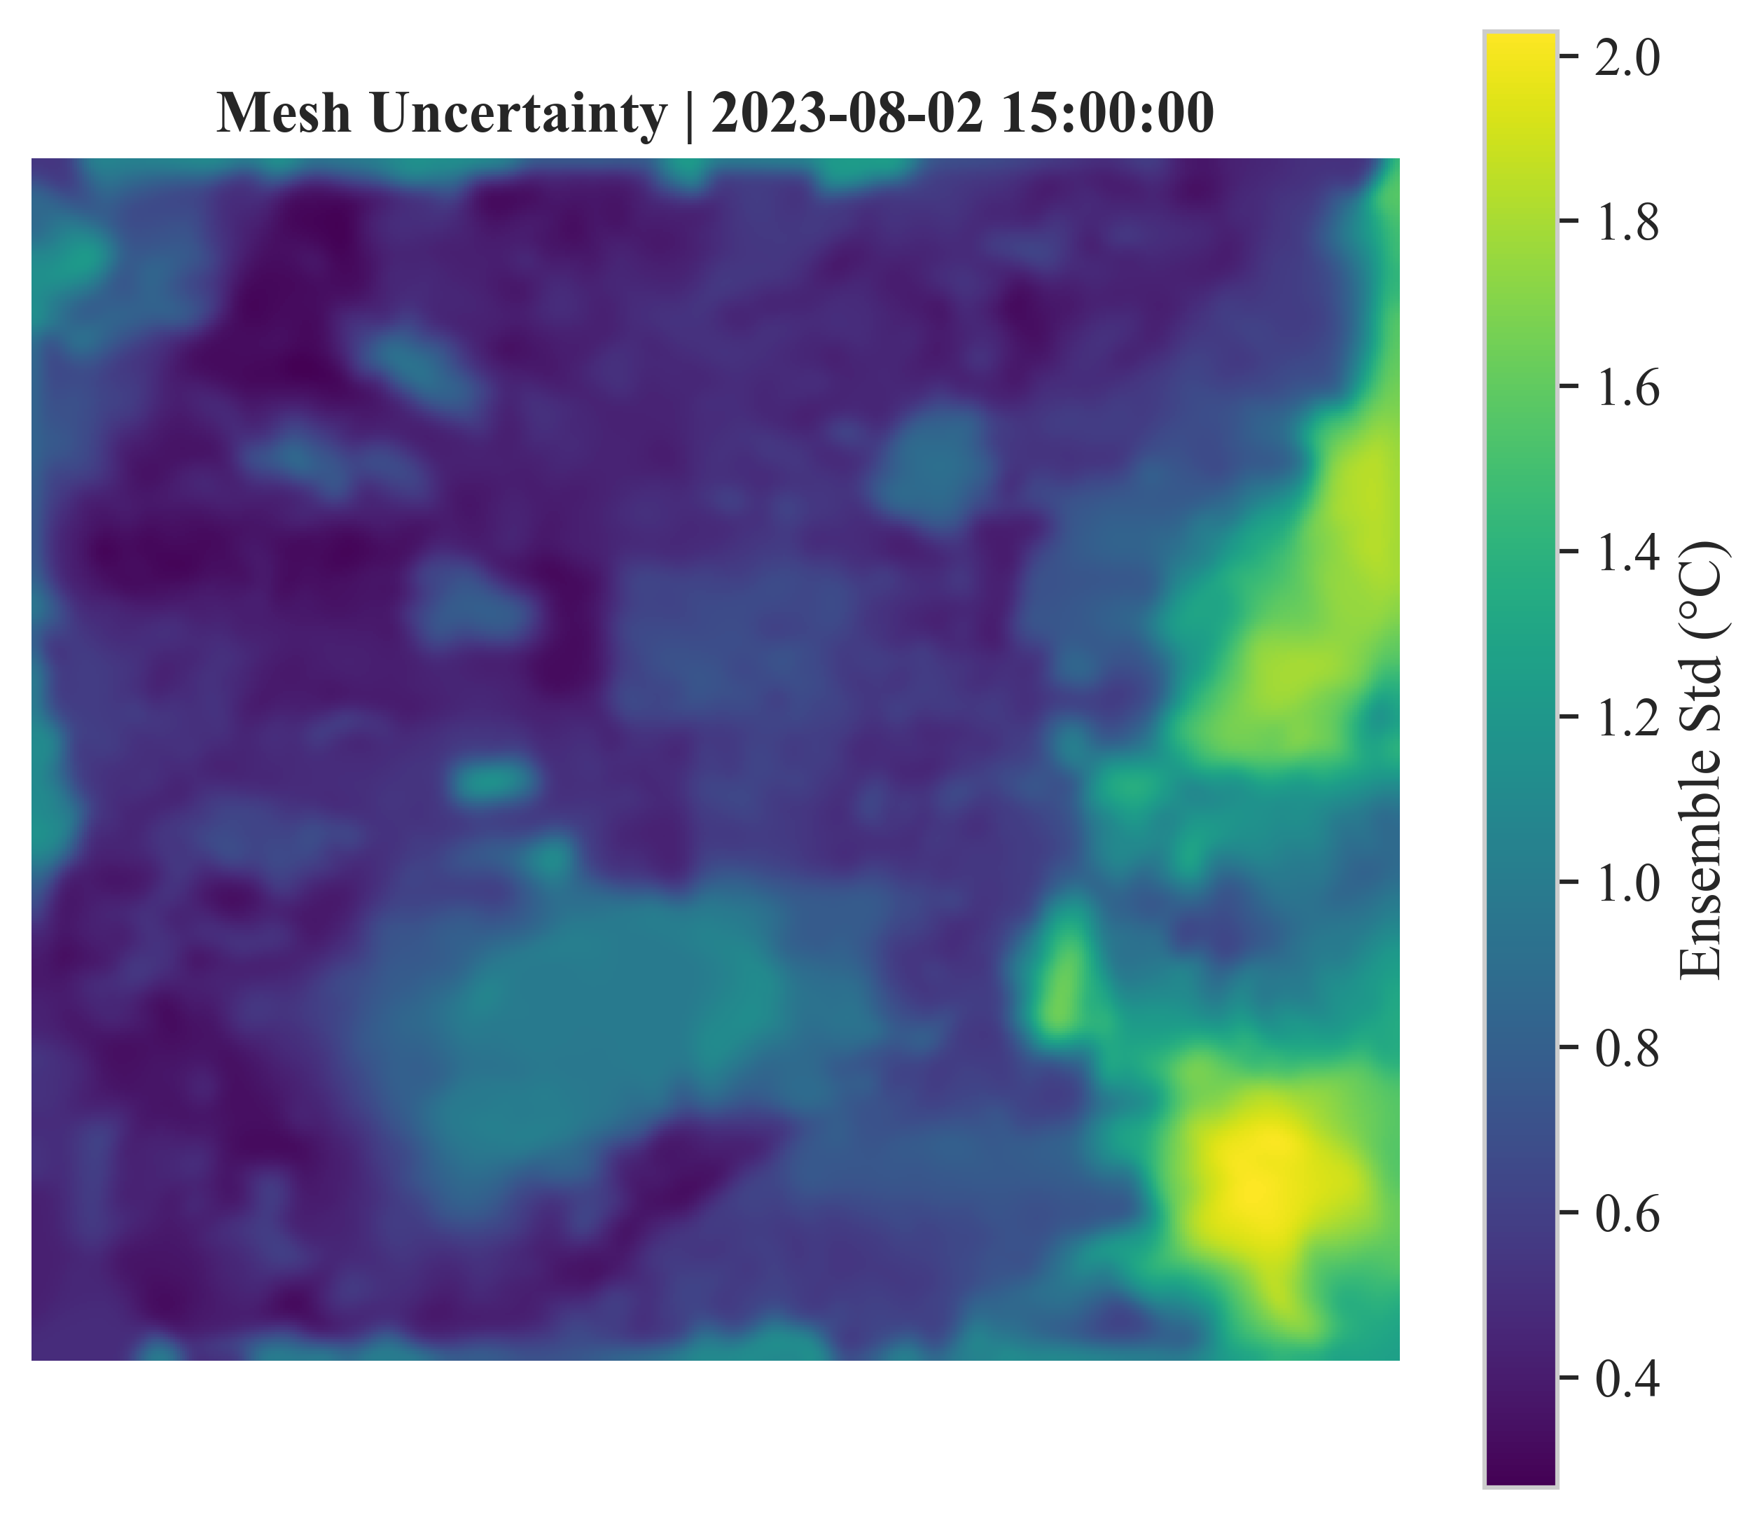
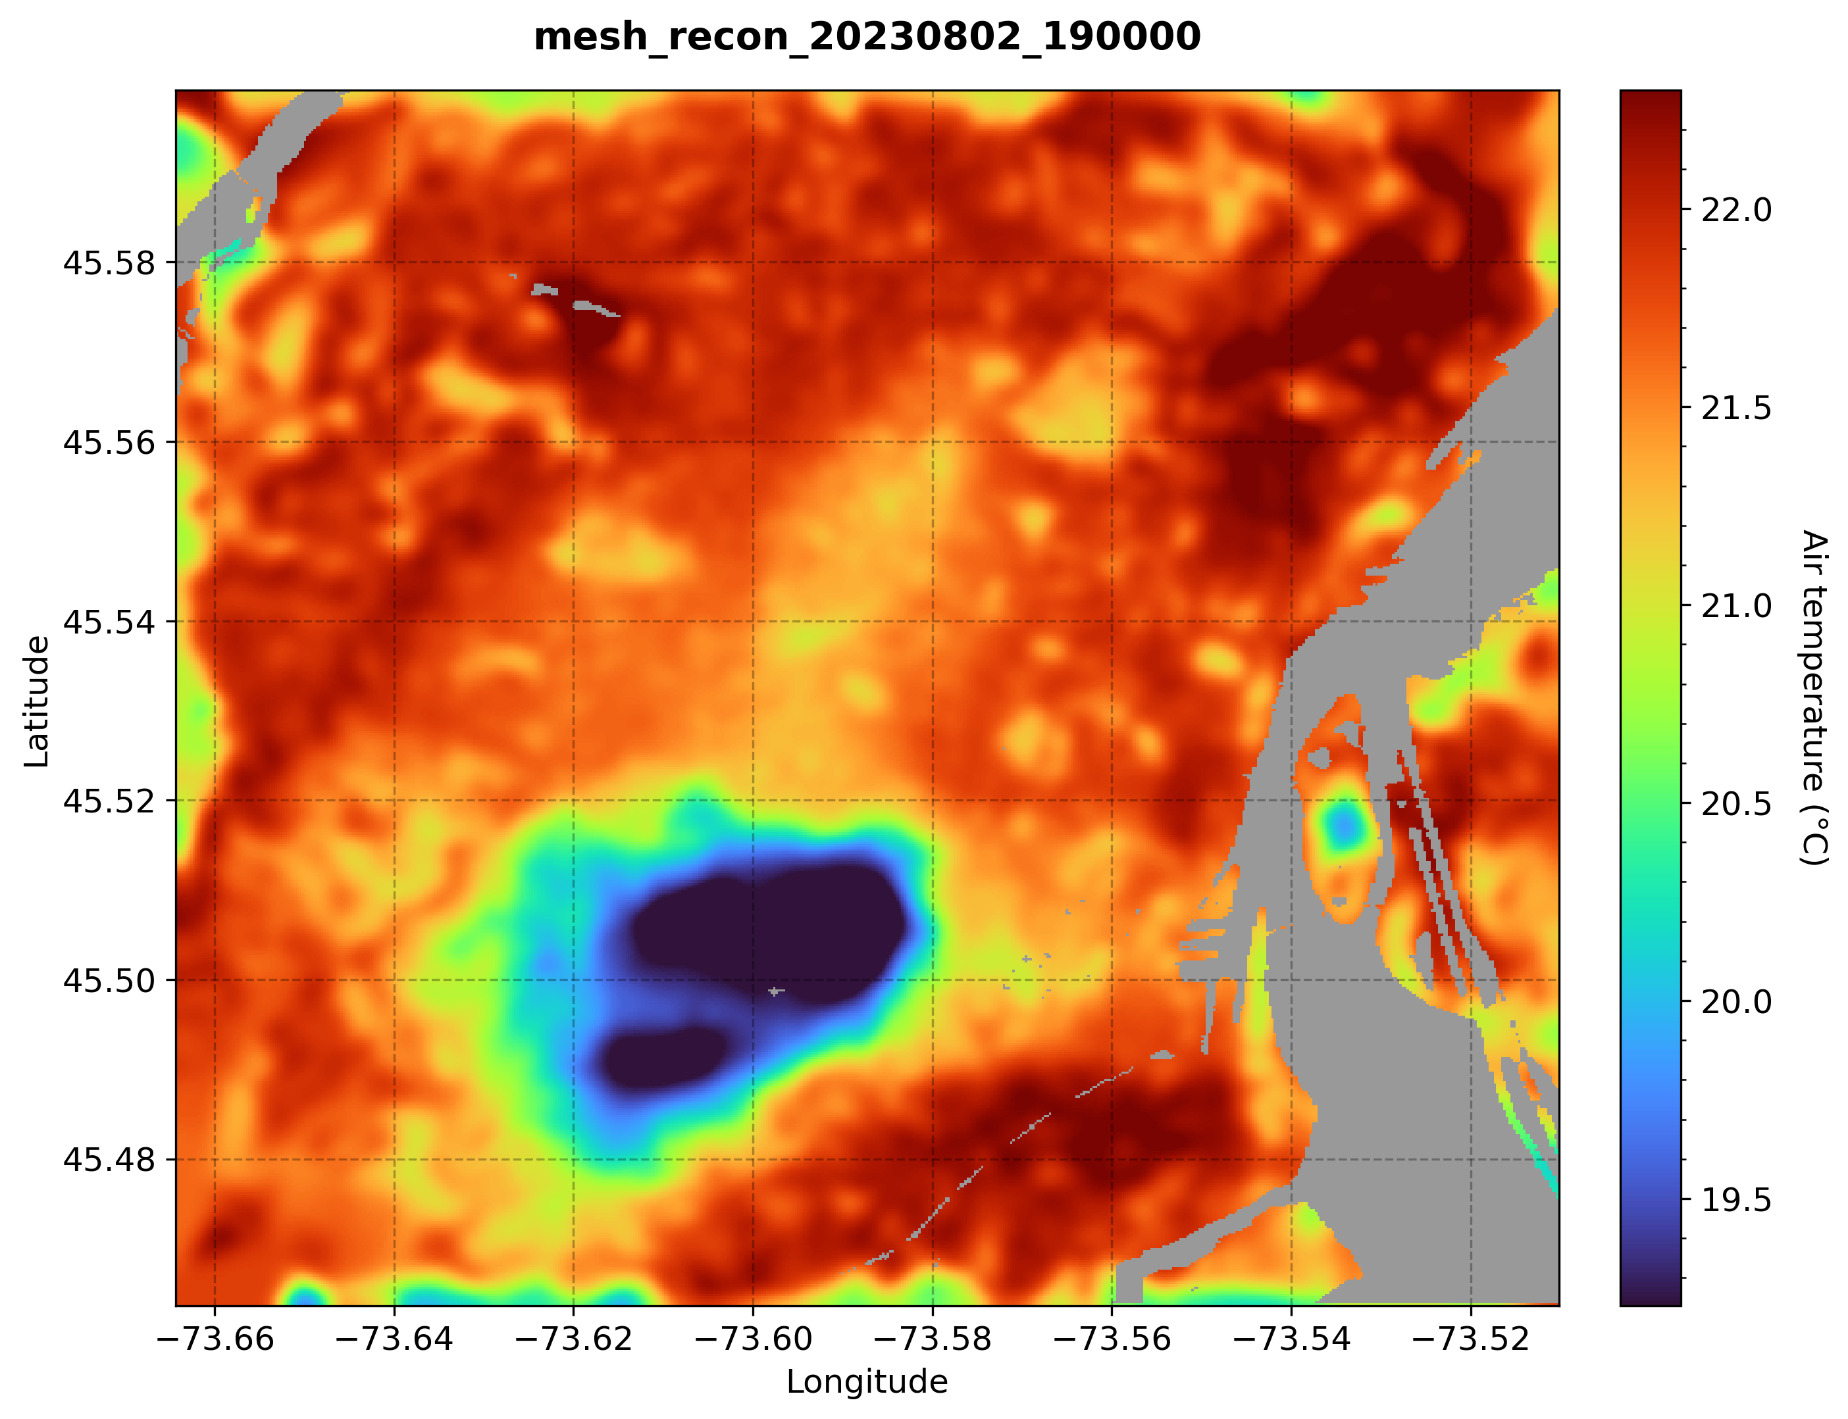
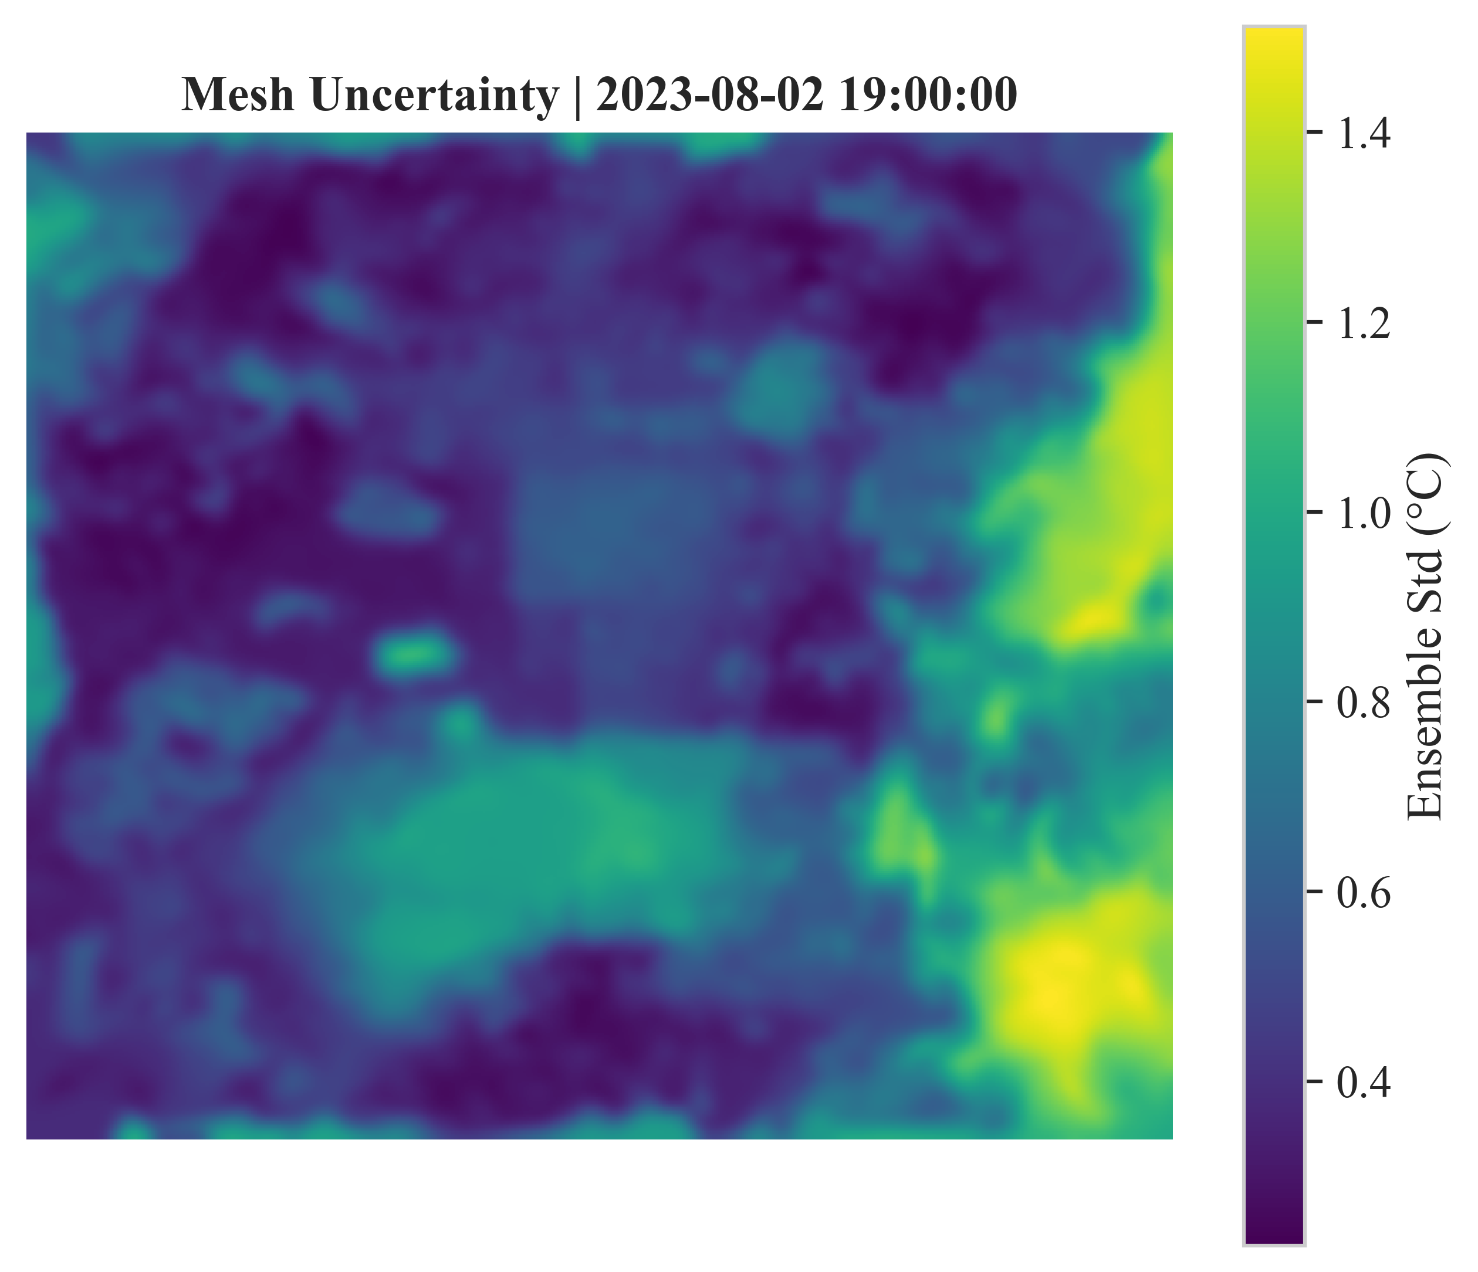
Main Results
RMSE | RMSE | MAE | MAE_STD | STATIONS
0.65917 | 0.262113 | 0.493766 | 0.20803 | 15

Slide 6
Main Results
STATION_ID | RMSE | MAE | N
S-THC 21317937:21326446 | 0.694407 | 0.523503 | 8672
S-THC 21317938:21206238 | 0.934664 | 0.781721 | 8731
S-THC 21317939:21326342 | 0.62975 | 0.470434 | 8665
S-THC 21317940:21326448 | 0.683042 | 0.52384 | 8700
S-THC 21317941:21348257 | 0.531703 | 0.367157 | 8673
S-THC 21317942:21326340 | 1.204263 | 0.931097 | 8734
S-THC 21317943:21326444 | 1.265205 | 0.933902 | 8719
S-THC 21317947:21348259 | 0.537641 | 0.398991 | 8690
S-THC 21317948:21326445 | 0.653392 | 0.436987 | 8668
S-THC 21317949:21206231 | 0.501637 | 0.337436 | 8702
S-THC 21317950:21326337 | 0.482117 | 0.376416 | 8706
S-THC 21317953:21348258 | 0.536051 | 0.401664 | 8653
S-THC 21317958:21206230 | 0.412219 | 0.302888 | 8702
S-THC 21317959:21326443 | 0.4304 | 0.319734 | 8674
S-THC 21317960:21336805 | 0.391066 | 0.300716 | 8743

Slide 7
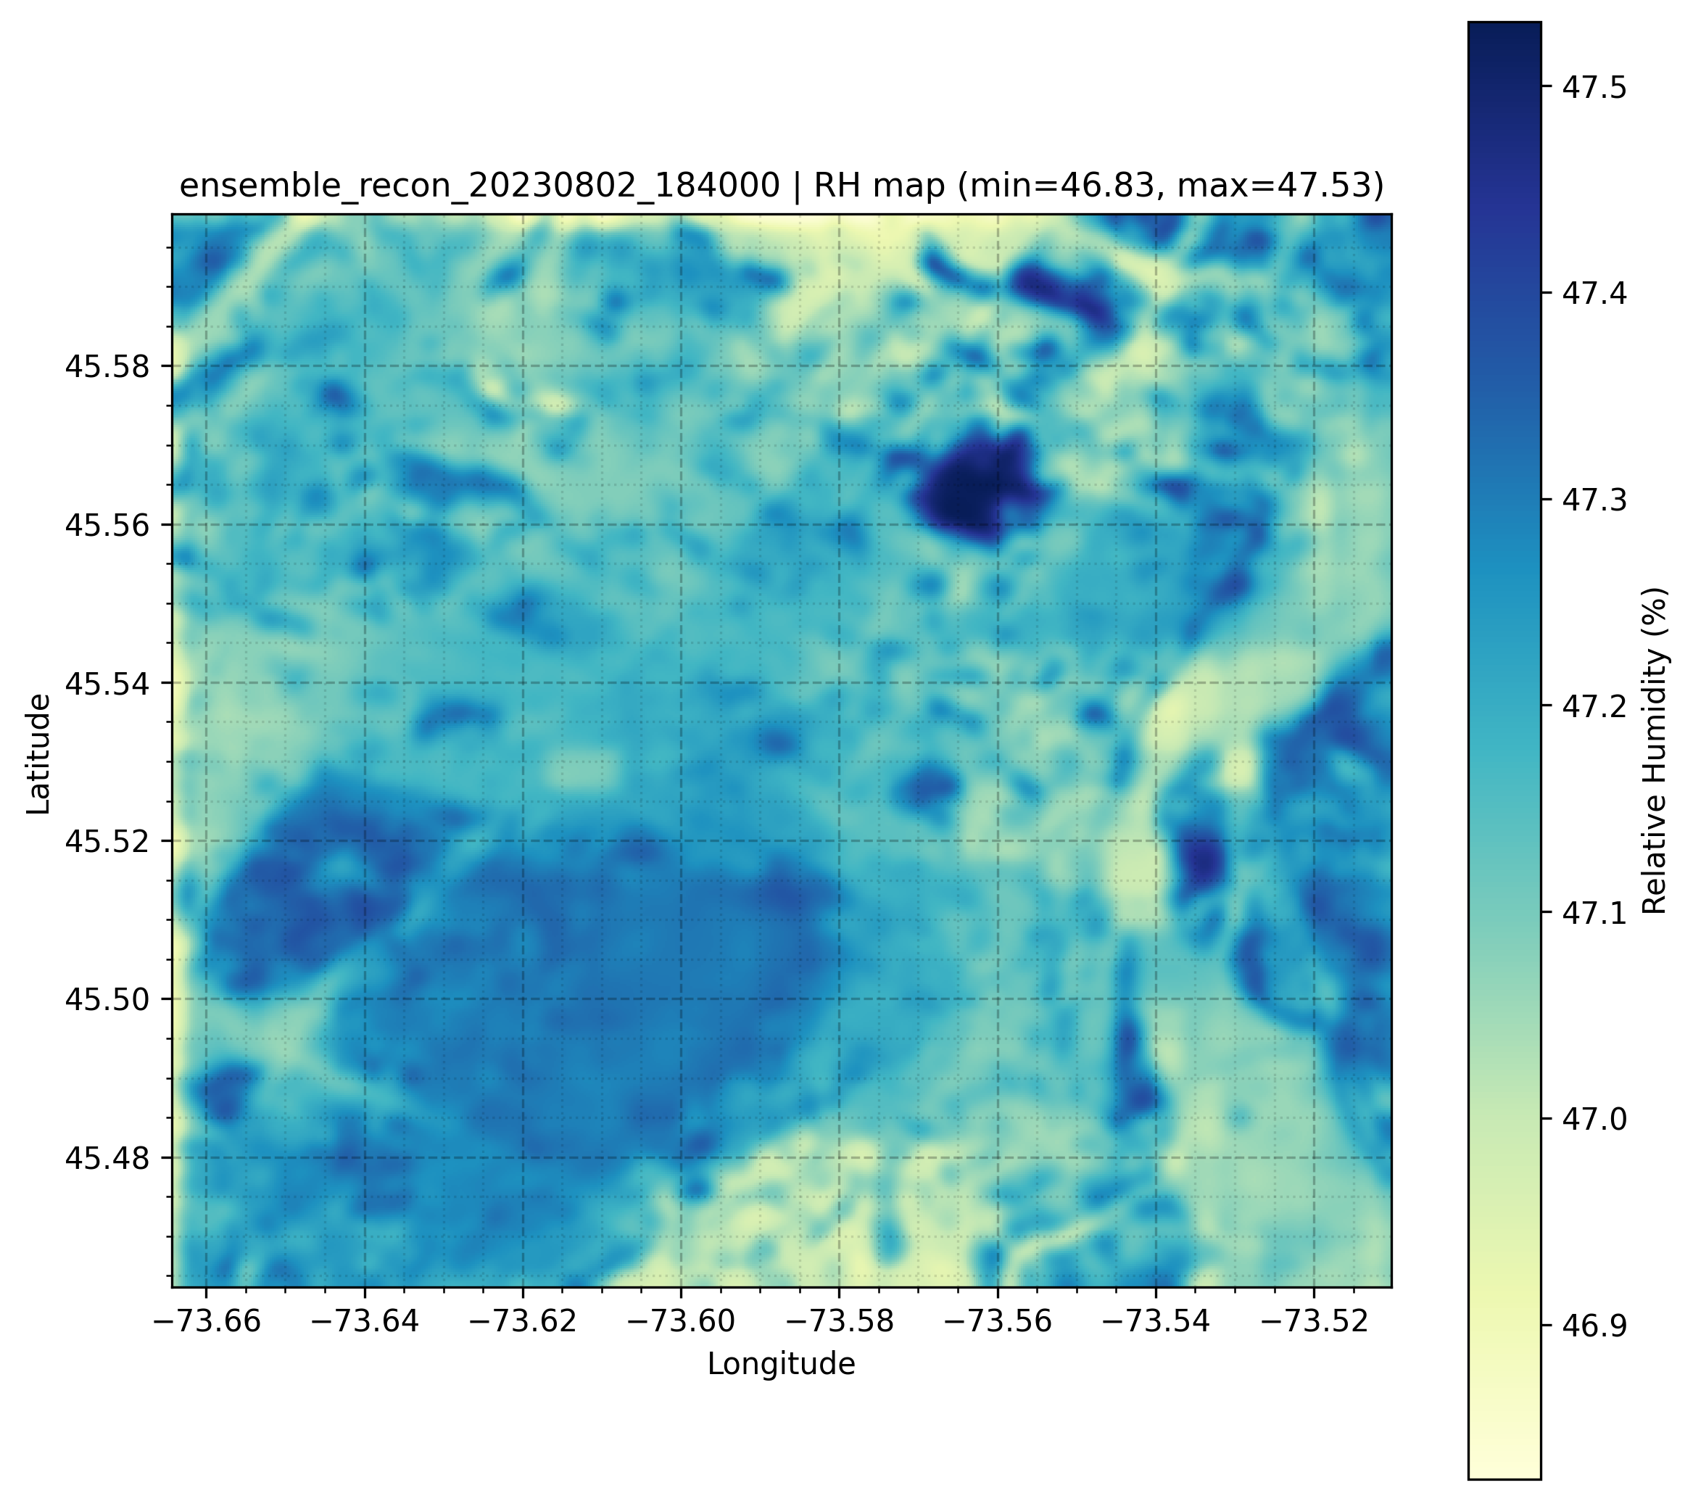
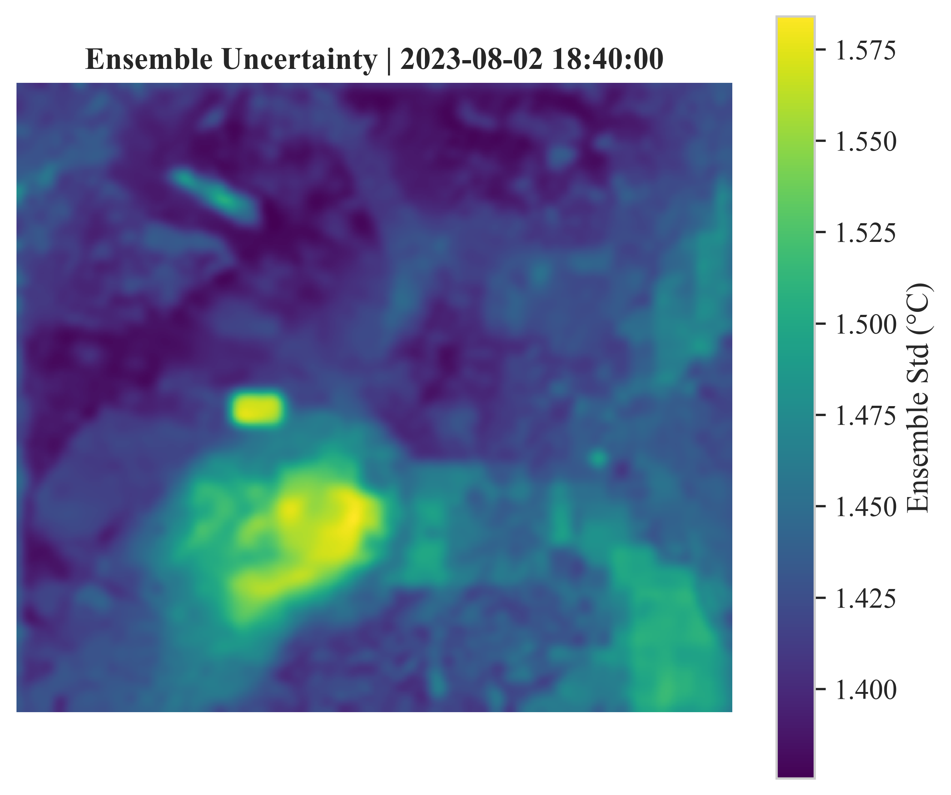
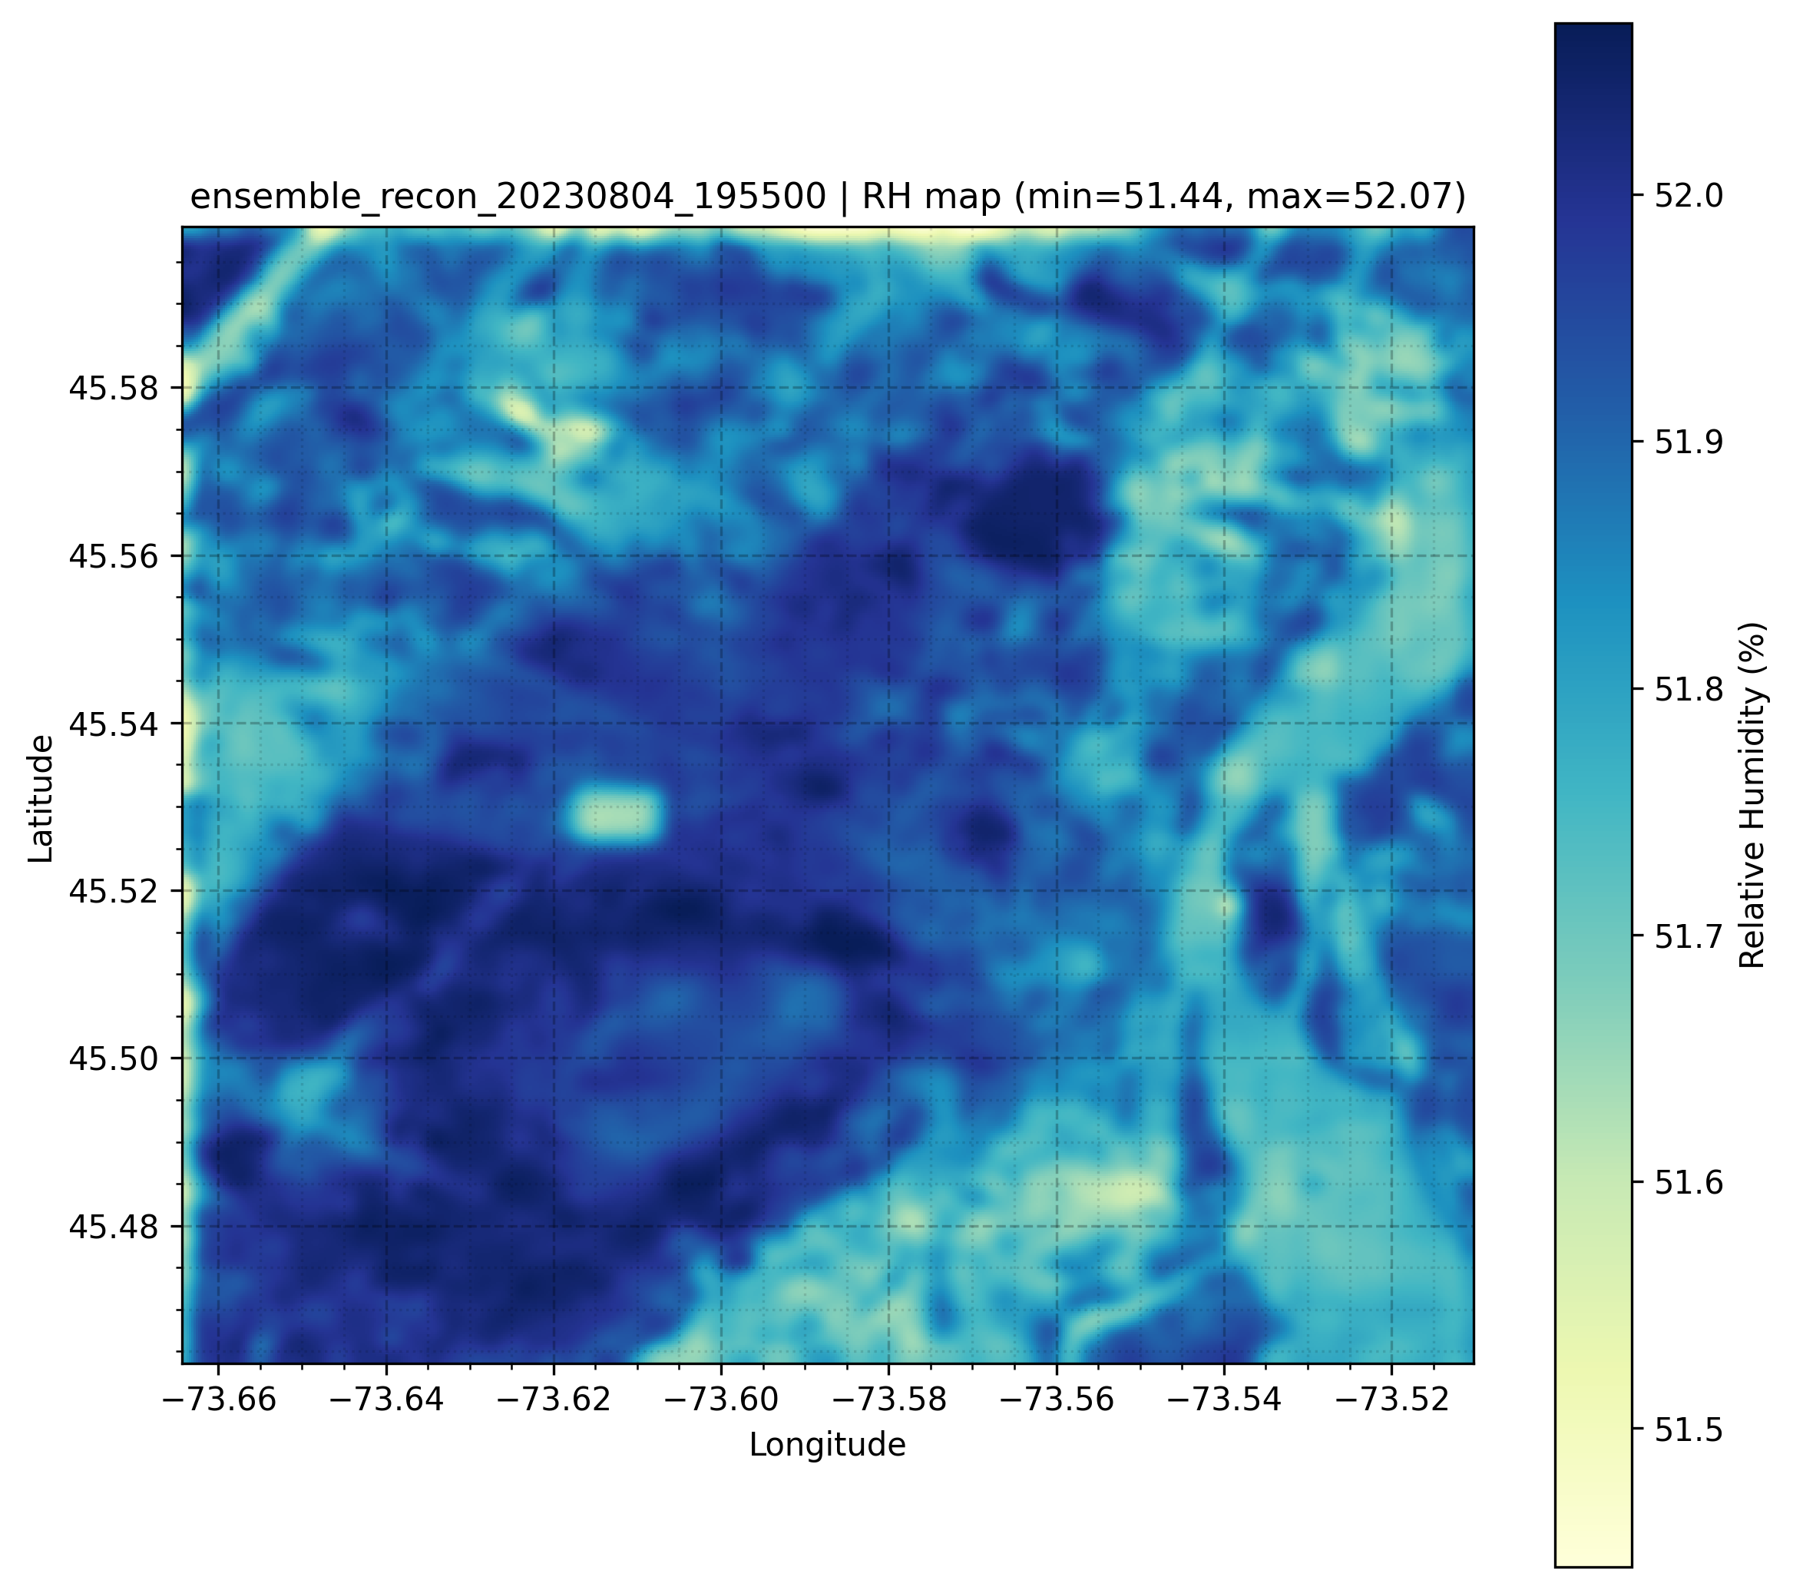
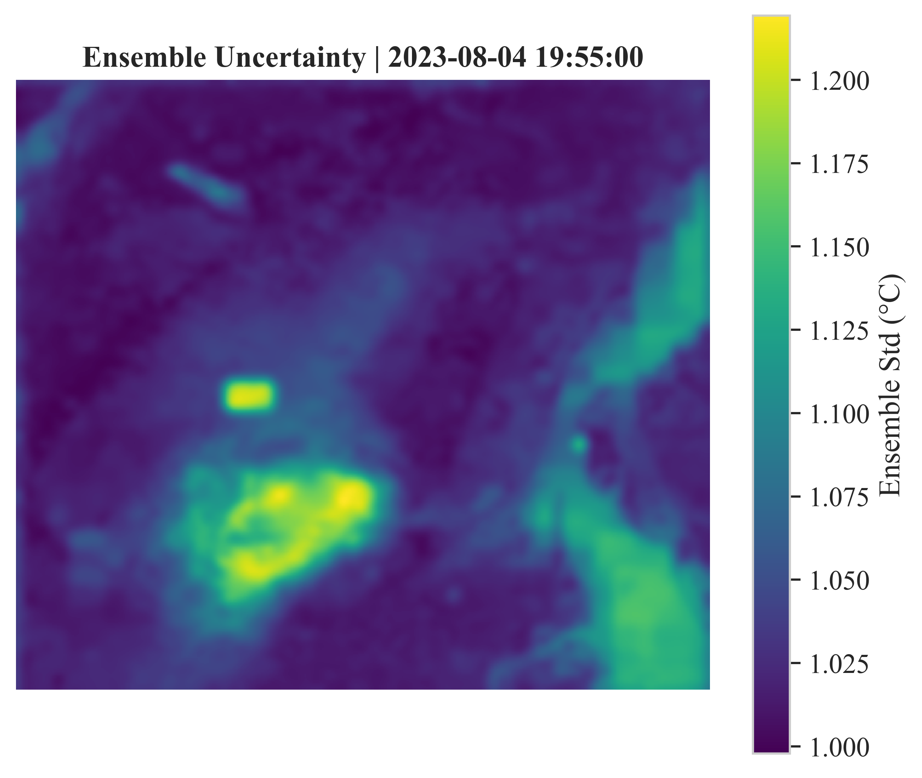
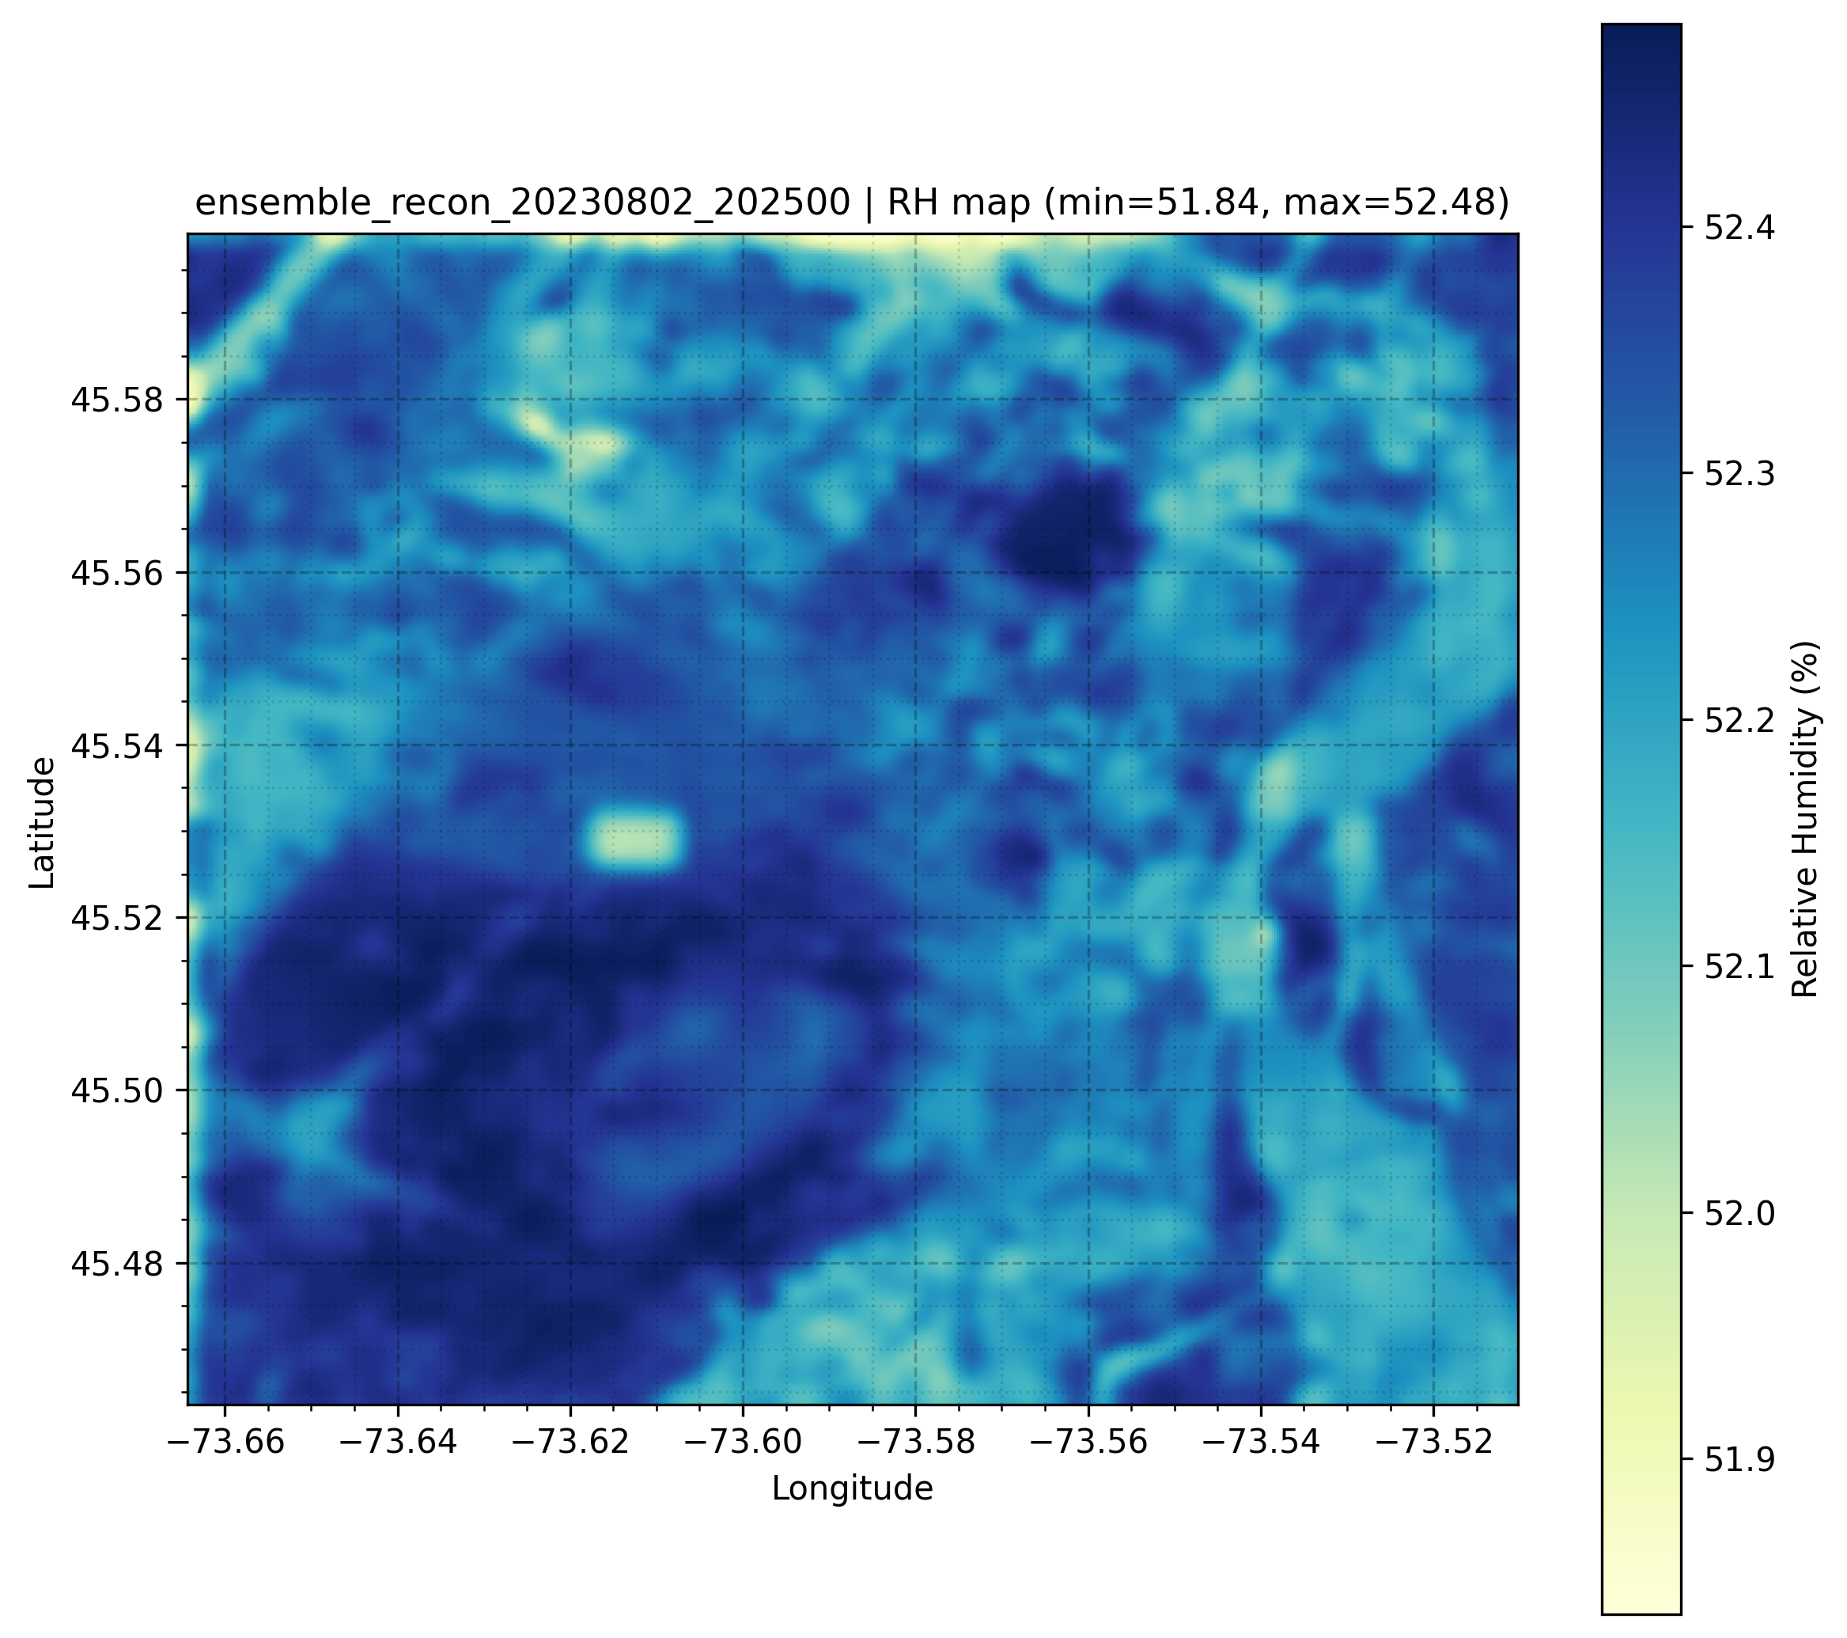
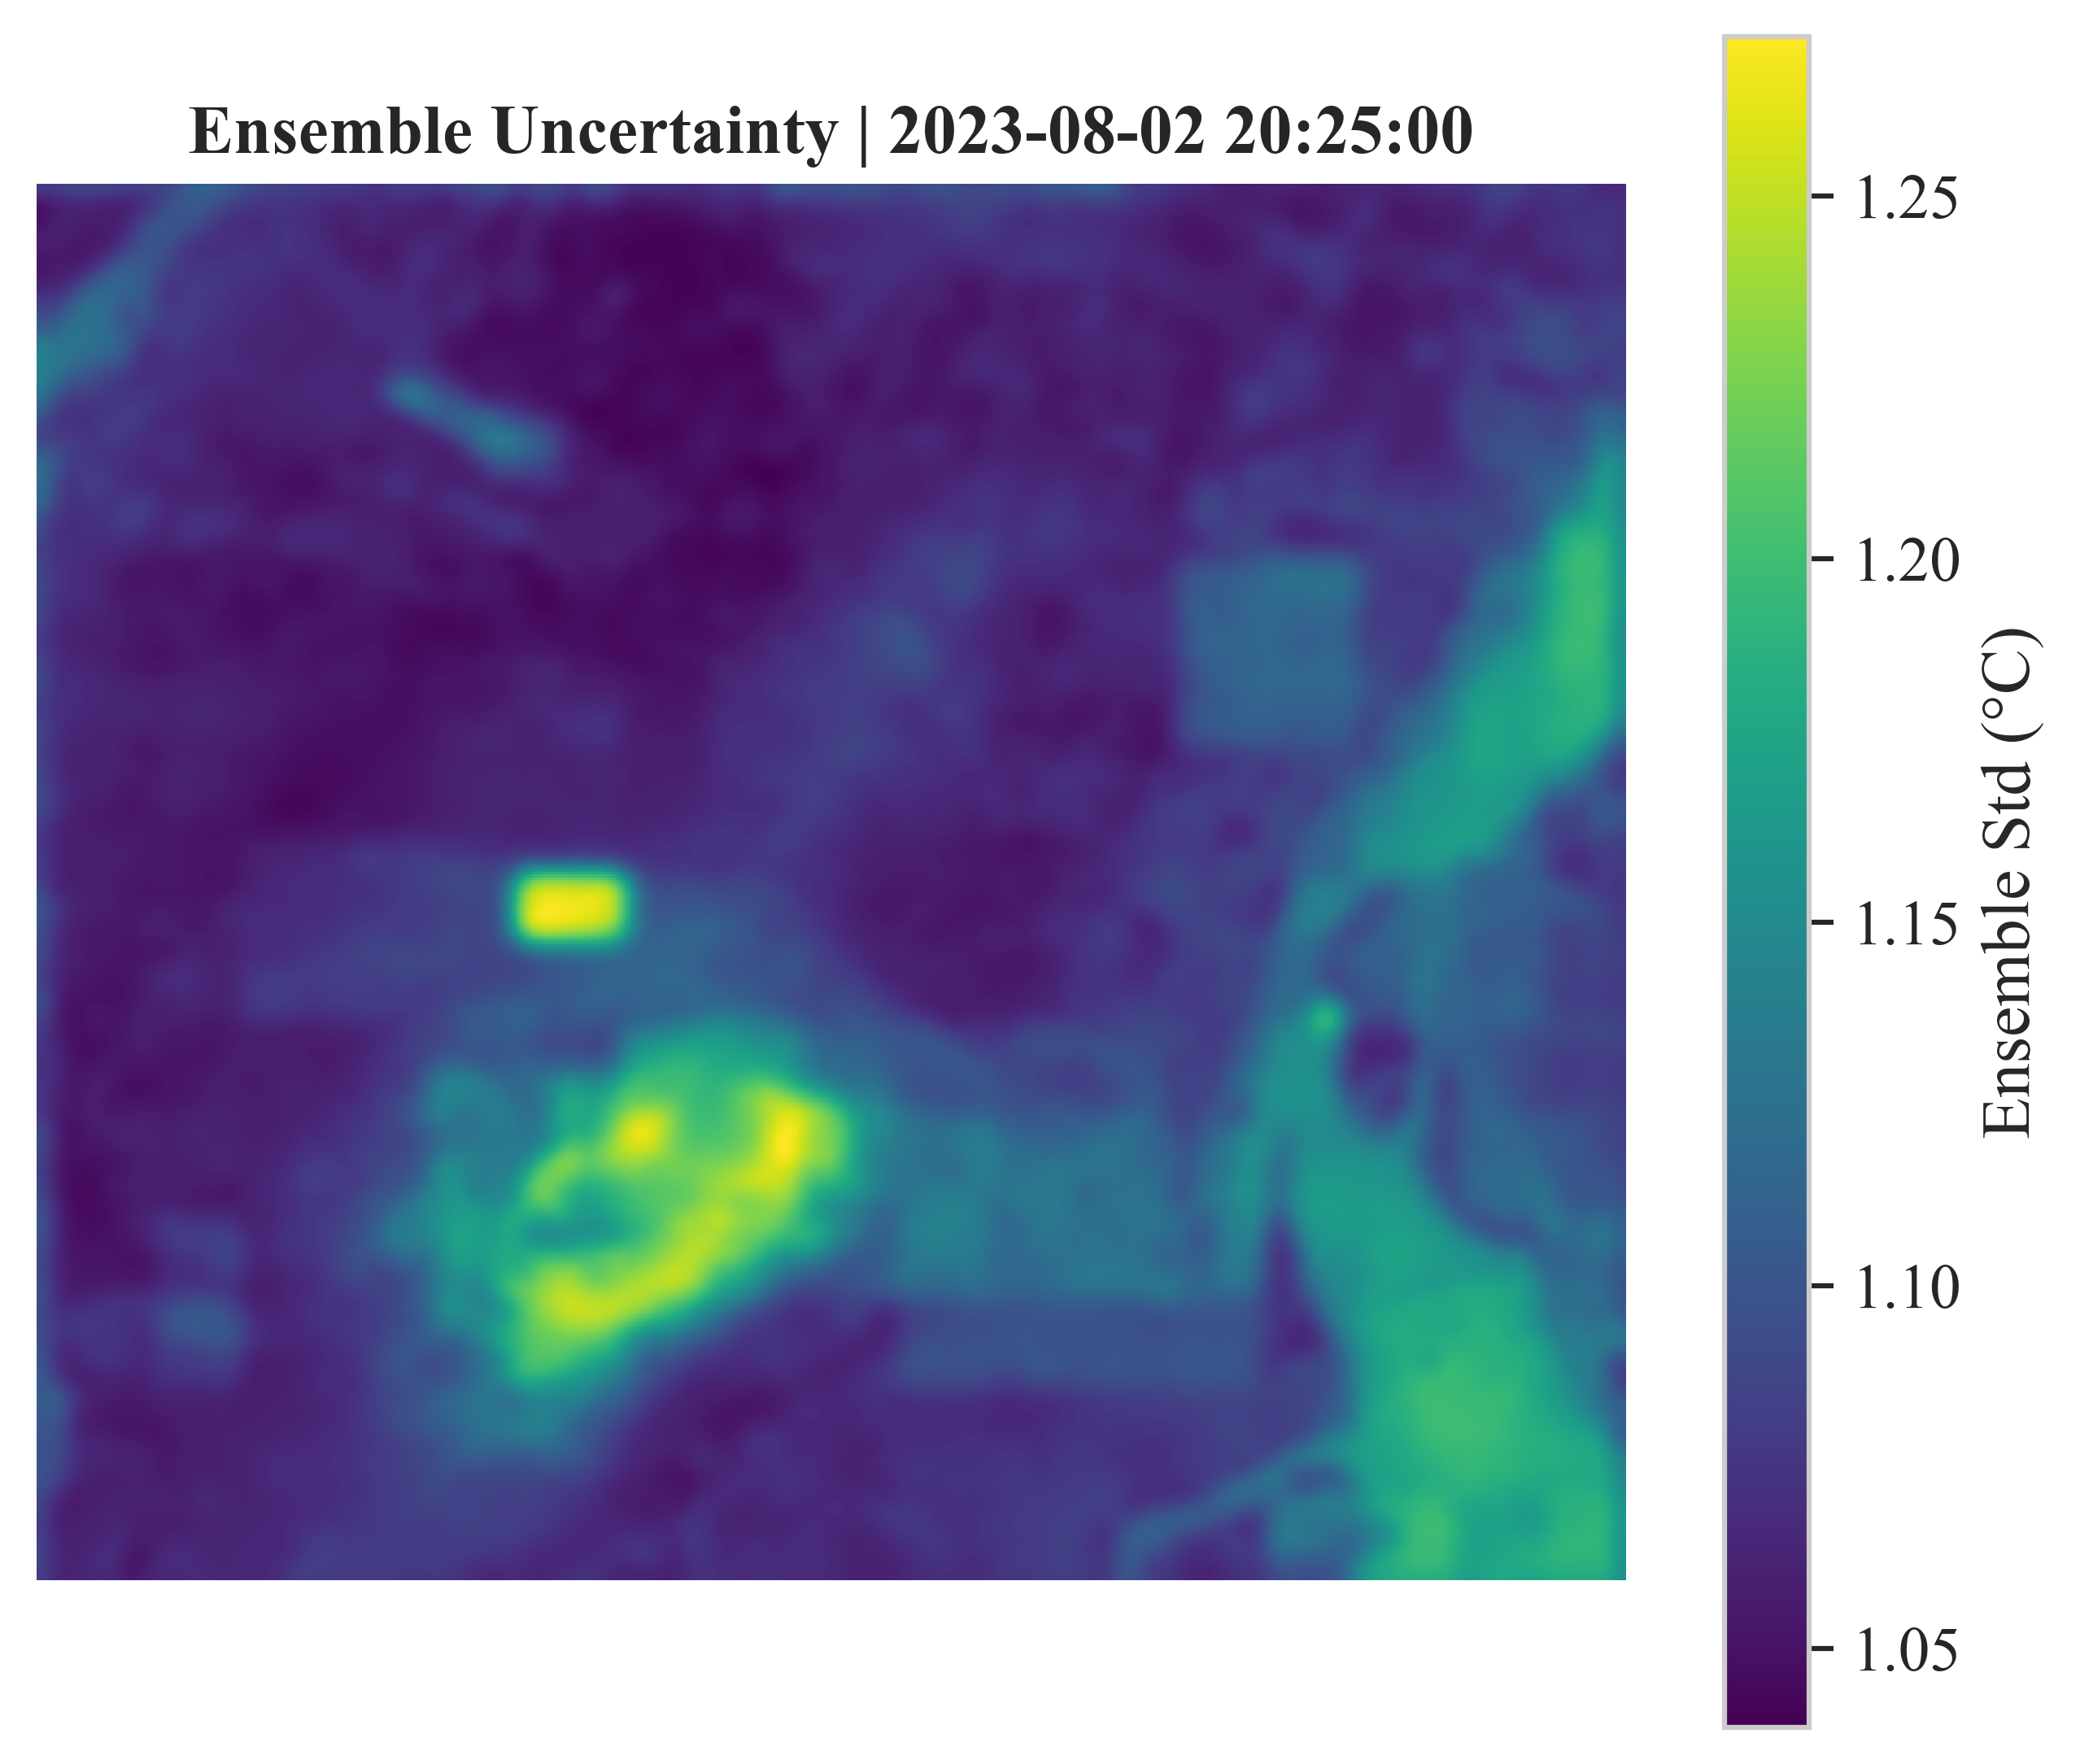
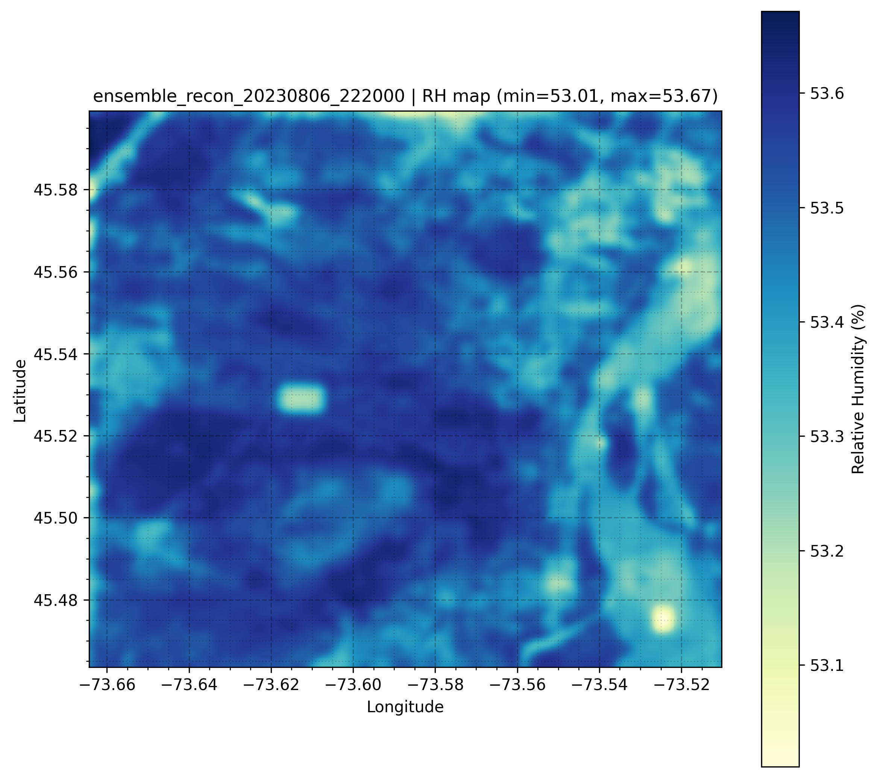
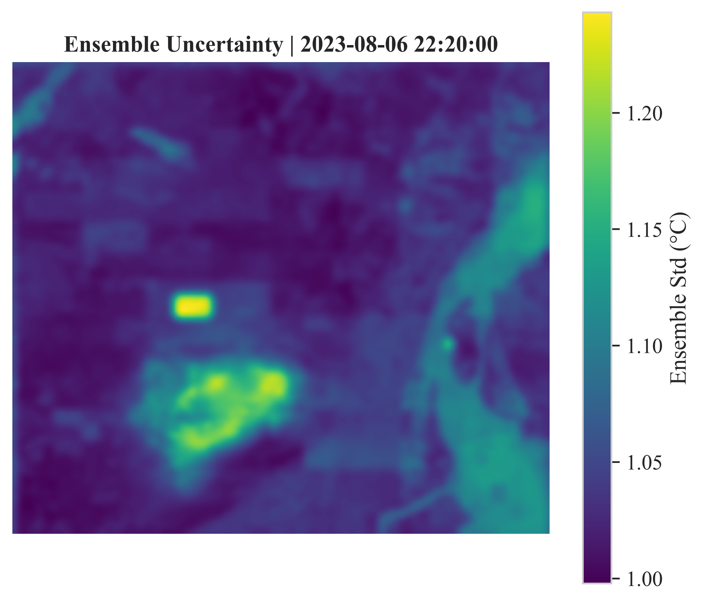
Main Results - RH
rmse_mean rmse_std mae_mean mae_std stations
3.554941035 1.867964444 2.903102025 1.645808726 15
RMSE_MEAN | RMSE_STD | MAE_MEAN | MAE_STD | STATIONS
3.554941 | 1.867964 | 2.903102 | 1.645809 | 15

Slide 8
Conclusions
GAT can perform high Fidelity air temperature and RH field reconstruction.
Capture complex urban thermal dynamics even where there are no sensors providing a continuous air temperature field helping determine cold spot and hot spots.
Perspectives
Our preliminary results provide actionable insights for urban planning
Promising for urban heat island intensity studies in cities such as Montreal.
By using air temperature fields simulated by our model in cities can more effectively address the challenges of UHI and climate change

